Slide 1

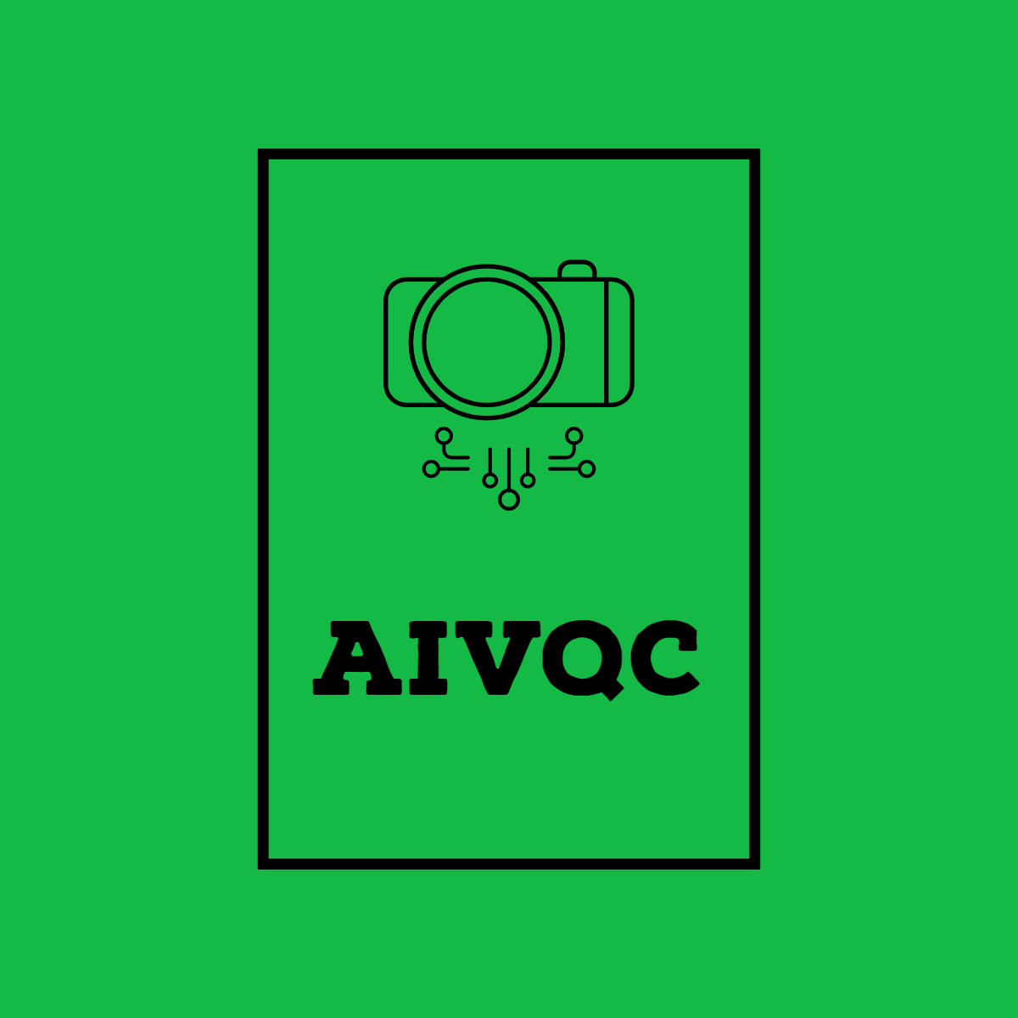
AI Visual Quality Controller
Dawid Olesko
S19005572

Slide 2

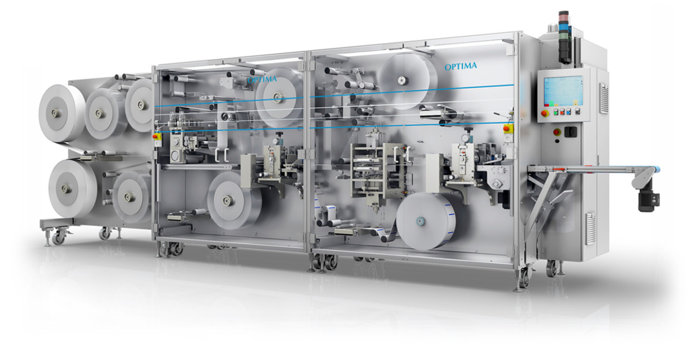
Medical Dressings Production
Zoom Shape 3
Sealing Section
Zoom Shape 2
Joining Section
Zoom Shape 1
Material Section
[1]

Slide 3
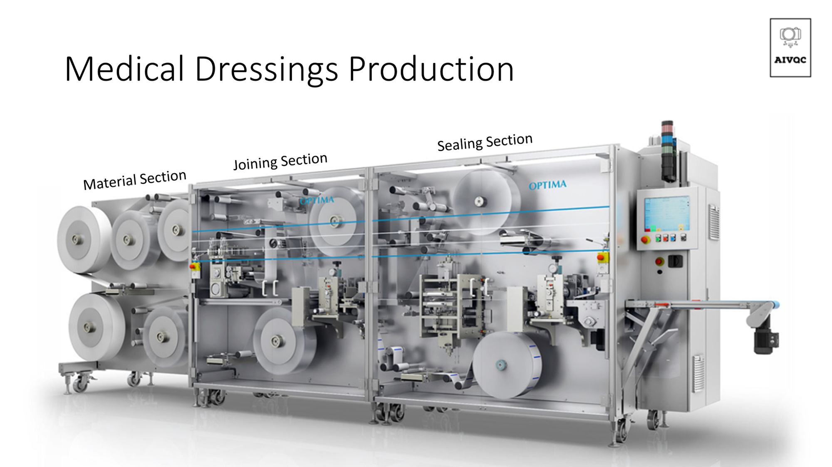

Medical Dressings Production
Medical Dressings Production
Sealing Section
Sealing Section
Joining Section
Joining Section
Material Section
Material Section

Slide 4
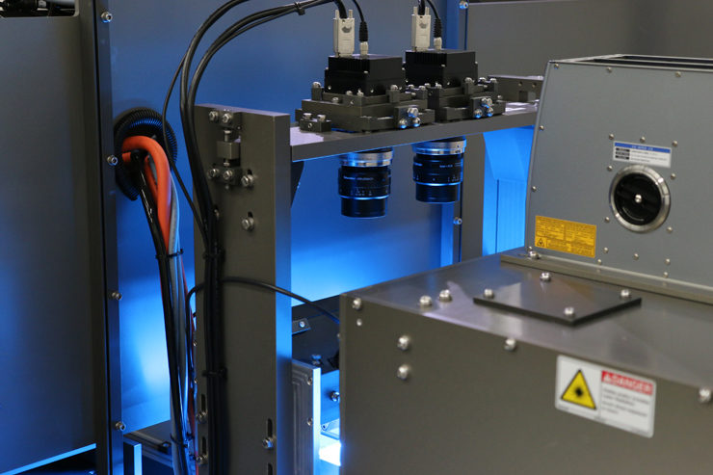


Current state of visual inspection
[3]
[2]
[5]

Slide 5


Vision System
Using traditional Machine Vision
Limited to measuring product dimensions
Implemented before sealing stage, cannot check final product

Slide 6
Visual inspection
Prone to fatigue, distraction, and subjective decisions, which can lead to error rates of 20-30% in manual inspection tasks [4]
Accuracy drops in highly repetitive tasks

Slide 7

QC checks
Random test performed by Quality Controllers
Test only a small sample of the product batch

Slide 8

Methodology
Literature Review
Data Collection
Data Pre-Processing
Model Selection
Model Training
Model Evaluation
Model Optimisation
Hardware Testing
System Integration
User Testing
Iteration and Improvement

Slide 9





Powered by:

Slide 10
Demonstration

Slide 11

Development and Experimentation
Object Detection
YOLOv4-tiny (You Only Look Once)
EfficientNet
Image Classification
MobileNet v3
Linux Implementation

Slide 12

Future Development
Adding new defect classes by transfer learning
Linux OS implementation
User Interface improvements
Support for production line sensors
Installation Package

Slide 13

Conclusion

Slide 14

Questions?

Slide 15

References

Slide 16
References
[1] Optima, "Manufacturing and Packaging Machine OPTIMA MDC150," Optima, 2023. [Online]. Available: https://www.optima-packaging.com/en/machine-solutions/manufacturing-and-packaging-machine-optima-mdc150. [Accessed 10 05 2023].
[2] NAS, "In-Line Multi-Purpose Line-Scan Vision System," Northfield Automation Systems, [Online]. Available: https://northfieldautomation.com/solutions/systems/in-line-vision/. [Accessed 17 05 2023].
[3] UFP MedTech, "Shaping solutions that rise above the ordinary," UFP MedTech, [Online]. Available: https://ufpmedtech.com/capabilities/. [Accessed 17 05 2023].
[4] E. Goffin, "Bringing AI to Visual Inspection," Quality Magazine, 01 01 2022. [Online]. Available: https://www.qualitymag.com/articles/96809-bringing-ai-to-visual-inspection. [Accessed 26 03 2023].
[5] CutSheetLabels, "CutSheetLabels," CutSheetLabels, 28 02 2019. [Online]. Available: https://cutsheetlabels.com/blog/quality-control-checks-label-production/. [Accessed 17 05 2023].

